Slide 1

Language Identifier
Guided by:
k. Vijaya Bhaskar
Done by:
A. Konda reddy(192210642)
M. Manoj(192211728)

Slide 2


Introduction to Language Identification
Language identification is the process of determining the language of a given text. This is a fundamental task in natural language processing, with applications in various domains like machine translation, text classification, and search engines.

Slide 3


The Significance of Language Detection in a Globalized World
In today's interconnected world, language barriers pose a significant obstacle to effective communication. Language detection plays a crucial role in bridging these gaps, allowing us to understand and interact with people from diverse linguistic backgrounds. It empowers us to navigate a globalized landscape, fostering collaboration and understanding across borders. This presentation delves into the multifaceted world of language detection, exploring its importance, challenges, techniques, applications, and future possibilities.

Slide 4

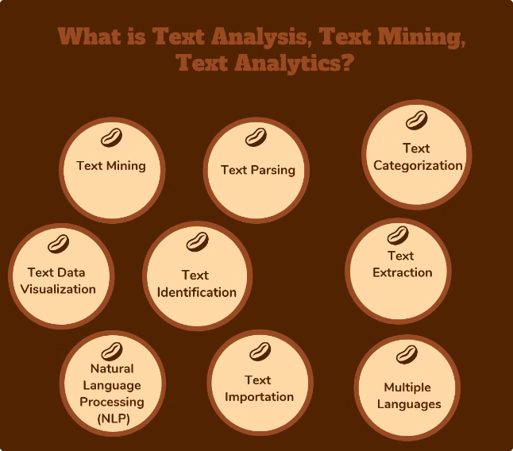
What is Language Identification?
Language identification is the process of automatically determining the language of a given piece of text. It involves analyzing the text's characteristics, such as its vocabulary, grammar, and writing system, to identify the language it belongs to.
Key Components
Language-Specific Features
The process typically involves tokenization, where the text is broken down into words or characters, followed by feature extraction, where language-specific features are identified.
These features can include the frequency of certain words, character sequences, or grammatical patterns that are unique to a particular language.

Slide 5

The Importance of Language Identification
1
Multilingual Communication
2
Personalized User Experiences
Language identification is crucial for enabling effective communication across languages. It allows for accurate translation, providing access to information and resources in different languages.
Language identification plays a key role in tailoring user experiences. Websites, apps, and devices can automatically adapt their language based on the user's preferences and location.
3
Content Analysis
4
Security and Surveillance
Language identification is essential for analyzing large datasets of text. It allows for the categorization of content, understanding audience demographics, and identifying trends in communication.
Language identification can be used in security and surveillance applications to identify potential threats, monitor communication, and ensure compliance with regulations.

Slide 6

Techniques for Language Identification
1
Character-Based Analysis
This technique analyzes the frequency of specific characters in the text to identify the language. It is a simple and efficient approach but may not be accurate for languages with similar character sets.
2
Word-Based Analysis
This method involves identifying specific words and phrases that are unique to a particular language. It relies on a database of words and their associated languages.
3
Statistical Language Modeling
This technique utilizes statistical models to predict the probability of a sequence of words based on its language. It analyzes the frequency of words and their relationships to identify the language.
4
Machine Learning Algorithms
Machine learning algorithms are increasingly used for language identification. They learn from large datasets of labeled text to identify patterns and features that distinguish different languages.

Slide 7




Challenges in Language Identification
Despite significant advancements, language identification faces challenges like dealing with code-mixed text, handling low-resource languages, and adapting to evolving language trends.
Code-Mixed Text
Identifying languages in text that contains words from multiple languages can be challenging due to the mixing of linguistic features.
Low-Resource Languages
Developing accurate language identification models for languages with limited available data is a significant challenge.
Evolving Language Trends
Language identification models need to be adaptable to changes in language use, such as the emergence of new slang or dialects.

Slide 8


Applications of Language Identification
Language identification has numerous real-world applications across various industries, including social media analysis, content moderation, and personalized user experiences.
Social Media Analysis
Understanding the languages spoken on social media platforms to analyze trends and sentiment.
Content Moderation
Identifying potentially inappropriate content in different languages to ensure safe and ethical online interactions.
Personalized User Experiences
Tailoring websites and apps to users' preferred languages, enhancing usability and satisfaction.

Slide 9

Challenges in Achieving Accurate Language Identification
1
Ambiguity
2
Dialect Variation
The complex nature of languages presents a significant challenge to language detection systems. Many languages share similarities in grammar, vocabulary, and pronunciation, making it difficult for algorithms to distinguish between them accurately.
Within a single language, dialects and regional variations can introduce significant differences in pronunciation, vocabulary, and grammar. These variations can confuse language detection systems, leading to misclassifications.
3
Code-Switching
4
Limited Data Availability
Code-switching, the practice of mixing two or more languages within a single conversation, poses a major challenge for language detection algorithms. These systems often struggle to identify the dominant language in a code-switched text.
For less-resourced languages, the availability of training data for language detection models is often limited. This scarcity of data can hinder the development of accurate and reliable language identification systems.

Slide 10

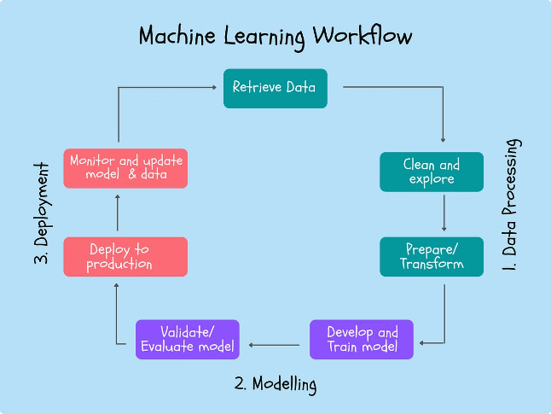
Supervised vs. Unsupervised Language Identification
Language identification methods can be categorized as supervised or unsupervised, depending on the availability of labeled data for training.
1
Supervised Language Identification
Requires a labeled dataset where each piece of text is associated with its corresponding language. The model learns from this labeled data to classify new text.
2
Unsupervised Language Identification
Does not rely on labeled data. Instead, it utilizes statistical methods or clustering algorithms to identify language patterns and group text based on similarities.

Slide 11

Machine Learning Approaches for Language Detection
1
Supervised Learning
In supervised learning, algorithms are trained on labeled data, where each example is associated with its corresponding language. The model learns to identify patterns in the data and make predictions for unseen text.
2
Unsupervised Learning
Unsupervised learning methods do not rely on labeled data. Instead, they cluster similar texts together based on their linguistic features. This approach can be useful when labeled data is limited.
3
Deep Learning
Deep learning techniques use artificial neural networks with multiple layers to process complex language features. These models are highly effective in achieving high accuracy in language detection.

Slide 12

Multilingual Language Identification
Challenges
Techniques
Multilingual language identification involves identifying the language of text that may contain multiple languages. This presents a challenge, as the system must account for the influence of different languages within the same text.
Methods include multi-class classification, where the system predicts the language from a set of possible languages. Ensemble methods combine multiple language detection models to improve accuracy.
Applications
Multilingual language identification is crucial for applications such as social media monitoring, machine translation, and cross-lingual information retrieval. It enables us to process and understand information from multiple languages.

Slide 13

Advantages of Language Detection
Improved Communication
Facilitates seamless communication across language barriers, fostering collaboration and understanding.
Enhanced Accessibility
Makes information and services accessible to a wider audience, regardless of their linguistic background.
Personalized Experiences
Enables customized experiences for users, delivering relevant content and services in their preferred language.
Increased Efficiency
Streamlines processes by automatically identifying languages, saving time and effort in manual tasks.

Slide 14

Disadvantages of Language Detection
1
Accuracy Limitations
2
Data Bias
Language detection systems may not always be completely accurate, especially when dealing with dialects, code-switching, or low-resource languages.
Training data can be biased, leading to inaccurate predictions for certain language varieties or dialects that are underrepresented in the data.
3
Privacy Concerns
4
Ethical Considerations
Language detection can raise privacy concerns, especially when used in sensitive contexts, such as monitoring social media or email communications.
The use of language detection technology should be approached with ethical considerations, ensuring fairness and equity in its application.

Slide 15

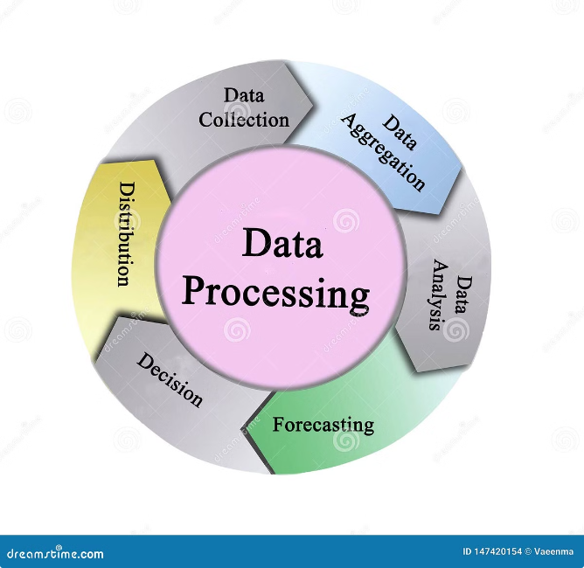



Language Identification Algorithms
Various algorithms are used for language identification, including statistical methods, machine learning algorithms, and deep learning models. The choice of algorithm depends on factors like data availability, accuracy requirements, and computational resources.
Statistical Methods
These methods analyze the frequency of characters, words, and other linguistic features to identify the language.
Machine Learning Algorithms
Algorithms like Support Vector Machines (SVMs) and Naive Bayes classifiers are trained on labeled data to classify languages.
Deep Learning Models
Deep neural networks, such as recurrent neural networks (RNNs) and convolutional neural networks (CNNs), have shown excellent performance in language identification.

Slide 16





Applications of Language Identification
Machine Translation
Language identification is used to determine the source language before translation, ensuring accurate translation between different languages.
Natural Language Processing
It enables text analysis, sentiment analysis, and information extraction by identifying the language of the text.
Information Retrieval
Language identification is crucial for retrieving relevant information from multilingual databases and search engines.
Social Media Analysis
It helps understand the demographics and trends of social media users by identifying the languages used in online communication.
Personalized User Interfaces
Language identification allows websites and apps to adapt their language based on the user's preferences, providing a personalized experience.

Slide 17


Future Trends in Language Identification
The field of language identification is continuously evolving, with ongoing research focusing on improving accuracy, handling new languages, and adapting to evolving language trends.
1
Multilingual Language Identification
2
Cross-Lingual Transfer Learning
Developing models that can accurately identify languages in multilingual text, where multiple languages are mixed within a single document.
Leveraging knowledge from high-resource languages to improve language identification for low-resource languages.
3
Real-Time Language Identification
Developing models that can identify languages in real-time, such as during live audio or video streaming.

Slide 18

Thank you

